Slide 1
Ethylene Production Via Cracking Of Ethane-Propane & the Issue Of Metal Dusting
Kelly Mao

Slide 2
Process Summary
Propane
Ethane
Naphtha
Ethane
Propane
Thermal Cracking
Quenching
Compression & Drying
Separation
Propylene
Ethylene

Slide 3
Thermal Cracking OVerView
Heat (steam/furnace can be used to provide heat)
Thermal Cracking is a process that uses heat and pressure to break down long-chained, higher-boiling hydrocarbons in crude oil to short-chained, lower-boiling hydrocarbons
H
H
H
H
H
H
H
Shorter-chained alkanes
H
C
C
C
C
C
C
C
H
Heptane (C7H16)
H
H
H
H
H
H
H
Alkanes
H
H
H
H
H
H
H
Alkenes/olefins
H
C
C
H
H
C
C
C
C
C
H
H
H
H
H
H
H
H
Ethene (C2H4)
Pentane (C5H12)

Slide 4
Thermal Cracking Typical Conditions
455 ℃ - 540 ℃ (850 - 1005 ℉)
100 - 1000 psi

Slide 5
Thermal Cracking Conditions
Mild Conditions = higher yields of gasoline components, decreased gas production, decreased coke production (lower quality gasoline)
Severe Conditions = higher gas production, increased coke production, decreased yields of gasoline (higher quality gasoline)
Higher temperatures increases the speed of conversions. However, this may change a reaction’s chemistry and does not necessary lead to higher target product yields

Slide 6
Quenching
Removes tar, coke, and other emissions
Thermal Cracking
Quenching
Water cools products and rapidly decreases temperature
Prevents further reaction/decomposition
Ethylene, propylene, and other cracking byproducts
Quenching is done in a separate container, often in large quench towers

Slide 7
Compression & Drying
CO2 and S are removed
H2O is removed
Caustic Scrubber
Molecular Sieves
Quenching
Compression
Drying
Cracked gas
Compressed cracked gas

Slide 8
Separation
Hydrogen gas, light hydrocarbons removed
Ethylene
Acetylene-Converter
C-2 Splitter
Ethane
Compression & Drying
Cold Box
CH4 + H2O = CO + 3H2
Deethanizer
Recycled
Thermal Cracking
Methane
Dried cracked gas
Demethanizer
Recycled
depropanizer
Propane
C-3 Splitter
Propylene

Slide 9
Disadvantages Of Thermal Cracking
Benefits Of Thermal Cracking
Enables Low Operating Pressure & High Operating Temperature
Conditions can be difficult and expensive to maintain
Potential for corrosion and metal dusting due to surfaces being in contact with hydrocarbons at high temperatures
Reduces the need for an expensive catalyst
External fuel needed for heating is costly
High yield of alkenes (e.g. ethene)
Large amounts of waste/undesired products (e.g. coke)

Slide 10
Importance Of Thermal Cracking
Thermal Cracking produces ethene. Ethene can be polymerized to produce polyethylene plastics.
Cracking is an important process for diesel fuel & commercial gasoline
low demand long-chained hydrocarbons → high demand short-chained hydrocarbons

Slide 11
Ways To Improve Thermal Cracking
Oxide protective layer on equipment to prevent metal dusting on equipment → decreased replacement costs
Use of solvents with hydrogen transfer properties to reduce coke formation
Coupon monitoring and acoustic monitoring preventive measures to detect corrosion

Slide 12
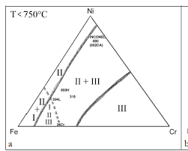
Metal Dusting
Metal dusting is the corrosion of metallic materials into dust (fine metal particles) at in a carbon-saturated atmosphere due to rapid carburization
Fe, Co, Ni base alloys are affected
Specific metal dusting mechanisms differ depending on the type of alloy and phase
Analysis must be done to find the best mitigation procedures.
Prominent issue in syngas, hydrogen, and ammonia production.
Oil cracking are facilities susceptible to metal dusting.

Slide 13
Metal Dusting Mechanisms
Type I: Decomposition Of Metal Carbides
Gas
Gas
Gas
Gas
C
Formation of cementite
Graphite (C)
Fe
Fe
Fe
Fe
C
Fe3C
Fe3C
Fe3C
Fe
Fe
Fe
Fe
Fe
Carbon diffuses
Fe3C = 3Fe + C
Metal atoms break away
C
Gas
Gas
Gas
Gas
C
C
Formation of cementite
C
Fe3C
Fe
Fe
Fe
Fe
Fe3C = 3Fe + C
Carbon diffuses
Graphite accumulation and defect formation
Gas enters cracks, encourages further metal dusting

Slide 14
Metal Dusting Mechanisms
Type II: Graphitization
Graphite
C
C
C
In nickel-based alloys, nickel acts as catalyst and the formation of metastable carbides is not part of the metal dusting process
Metal/Alloy
Metal & graphite act as catalysts

Slide 15
Metal Dusting Mechanisms
Type III: Active Corrosion By Carbon & Oxygen
Large metal particles & carbon deposit in surface
Chun Model
M7C3
Gas
carbon
Gas
Gas
Gas
graphite
Carbon dissolves and diffuses into metal
Oxide Film
M3O4
M3O4
M3O4
M3O4
M3O4
M3O4
M3O4
M3O4
Metal
Metal
Metal
Metal
Oxide film formation disrupted
Direct Carburization
Carbon Precipitation
Carbon Deposition
Gas
Metal atoms break away
M3O4
M3O4
Metal
Metal Dusting

Slide 16
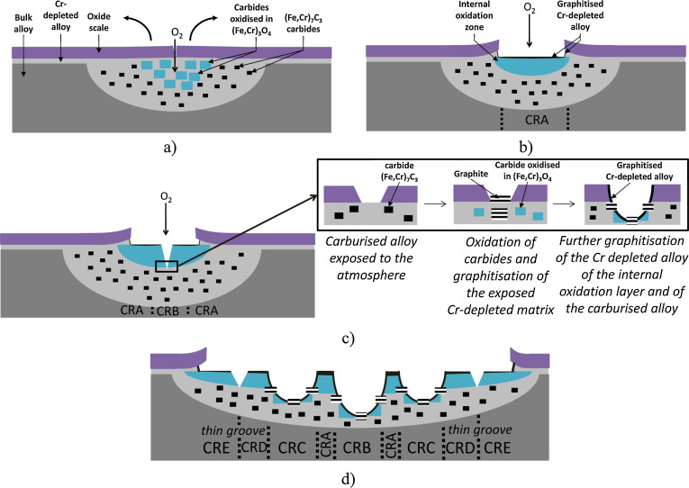
Metal Dusting Mechanisms
Type III: Active Corrosion By Carbon & Oxygen cont.
Fabus Model

Slide 17
Metal Dusting Mitigation techniques
Coatings
Thermal spray coatings can be a physical barrier to carbon but can be less effective depending in porosity
Aluminizing is the usage of an aluminum surface treatment to improve thermal corrosion resistance and can be effective around 1095 C
Oxide scales slow carbon diffusion and prevents carbon accumulation
Surface finish may prevent the initiation of metal dusting but results are still inconclusive

Slide 18
Metal Dusting Mitigation techniques
Alloy Element Addition
Chrome helps form oxide scale but can have negative effects in low allow steel, may encourage the formation of nucleation sites in cementite layer
Alloys with carbide-forming elements (Ti, Nb, Mo) initially degrade less but after corrosion starts metal wastage is severe
Columbium could reduce the rate of carburization in parent material
Silicon can make alloys more metal dusting resistant
Nickel generally beneficial but negative effects in sulfur environment
Copper in a Cu-base Ni-containing alloy heals the protective oxide scale

Slide 19
Metal Dusting Mitigation techniques
Operating Envelop
Additions of sulfur is used in cracking during ethylene production to prevent metal dusting. Sulfur slows the nucleation of graphite and stabilizes metastable carbides
Ethylene presence had been found to increase carbon formation rate
Increasing exposure temperature causes more oxide formation which reduces carbon deposition

